Slide 1
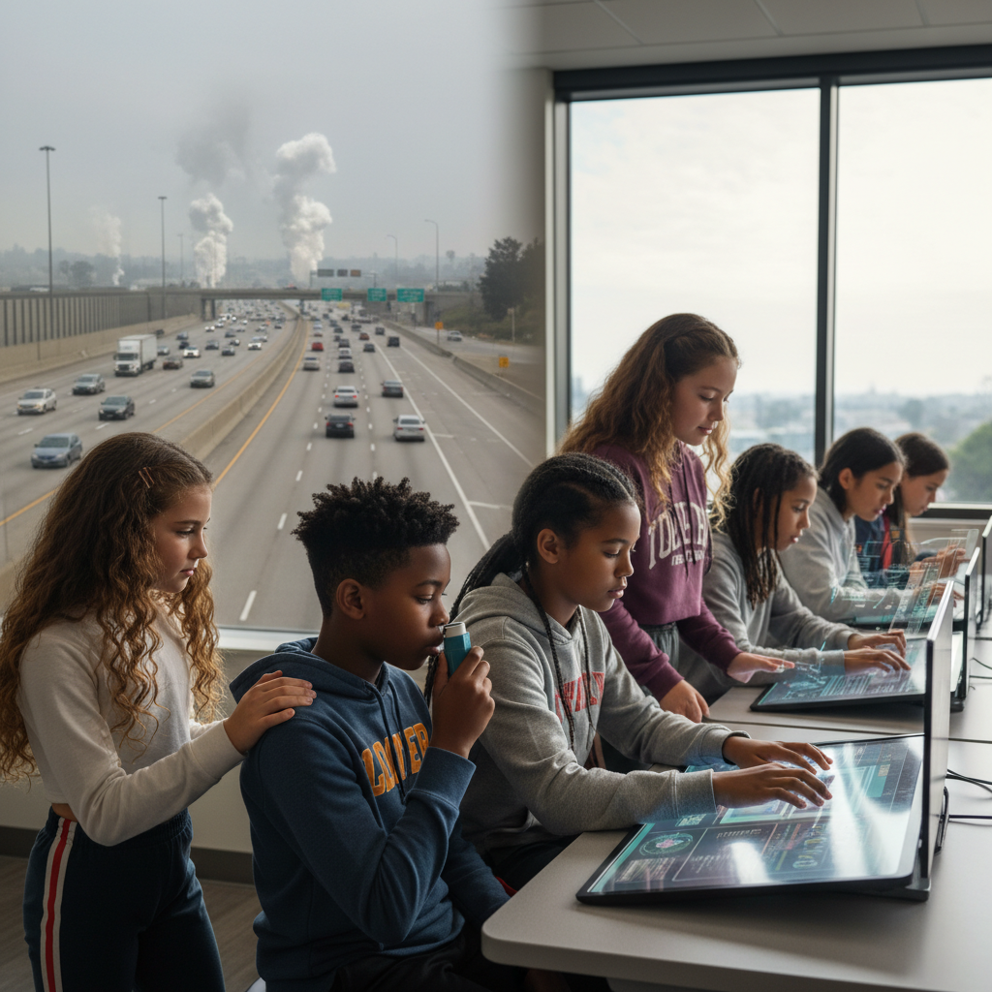
ModelIt!
Student Lesson
Whose Air Is This?
Why Kids Near Freeways Have Higher Asthma Rates
NGSS: 5-ESS3-1
5th Grade
1/9

Slide 2
What You Will Learn Today
Learning Goals
* Model how vehicle traffic and wind patterns determine air pollution levels
* Explain why communities near freeways experience higher respiratory illness
* Predict how changes in traffic or wind affect community health
* Identify scientific and community-based approaches to improving air quality
Key Vocabulary
Air Quality Index
A number measuring how clean or polluted the air is
Particulate Matter
Tiny solid or liquid particles floating in the air
Respiratory
Relating to the lungs and breathing system
Environmental Justice
The fair distribution of environmental risks
2/9

Slide 3
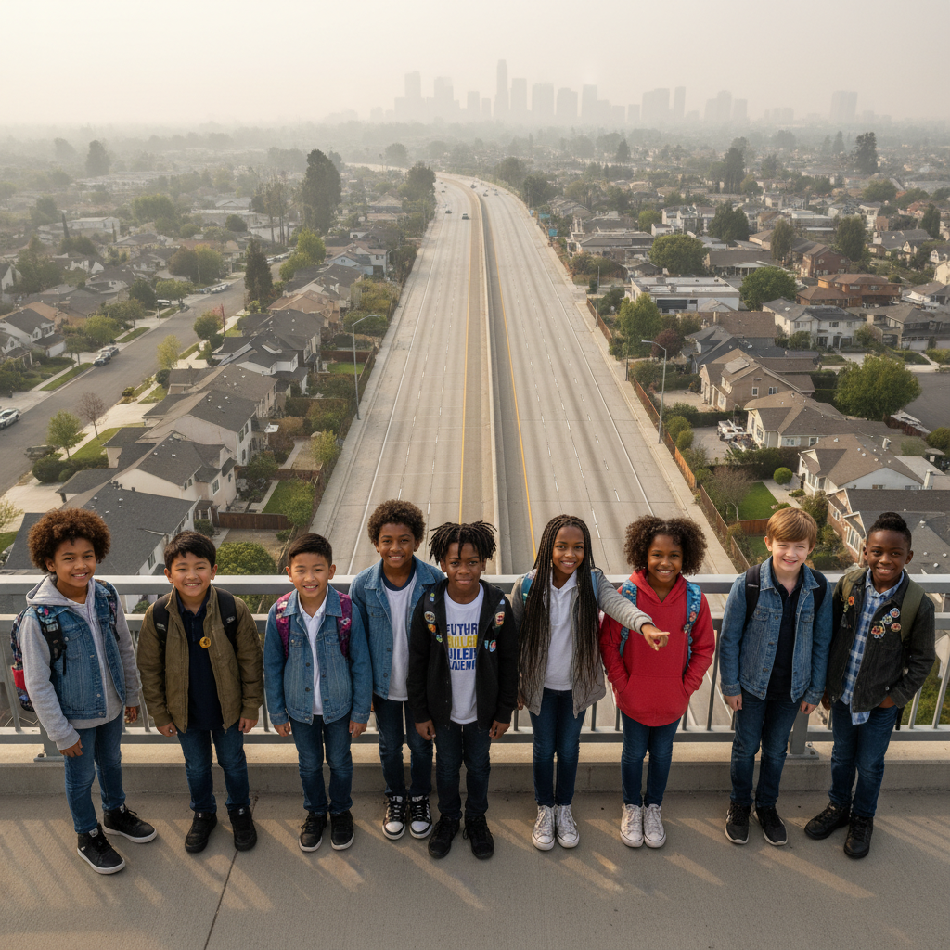
The Big Question
How do vehicle traffic and wind patterns determine what a community breathes?
Why Kids Near Freeways Have Higher Asthma Rates. Today we'll build a MODEL to discover the answer!
3/9

Slide 4
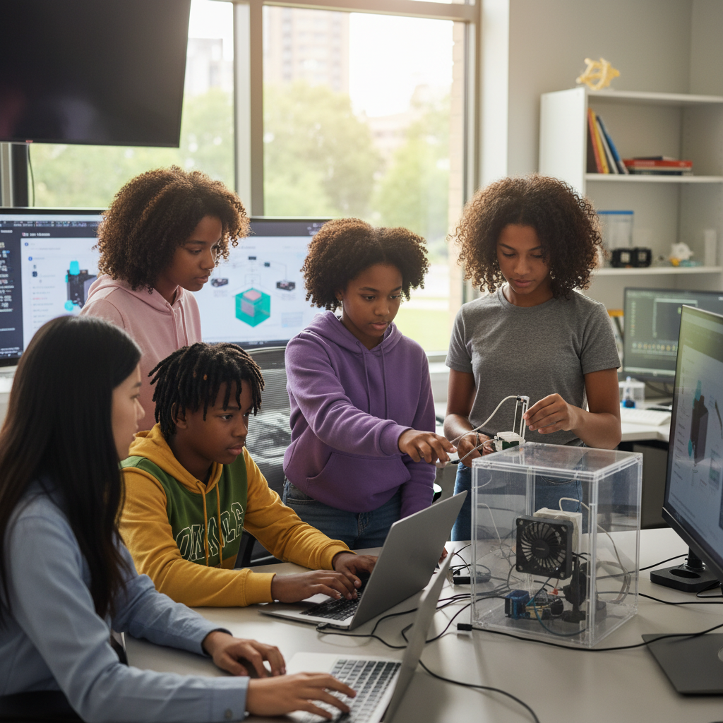
Today We Will Build a Model!
A model helps us understand complex systems!
1. LOCATE
Identify the COMPONENTS (parts) of the system
2. ESTABLISH
Connect them with RELATIONSHIPS (+ or -)
3. VISUALIZE
Build your model in ModelIt!
4. EVALUATE
Run SIMULATIONS to test scenarios
5. REVISE
Improve your model based on evidence
4/9

Slide 5

Activity 1: Sort the Components
Sort these components into EXTERNAL (inputs from outside) and INTERNAL (inside the system):
Your Components:
* Vehicle Traffic Density
* Wind Speed
* Air Pollution Concentration
* Respiratory Health Impact
Think: Which components can we control? Which happen on their own?
5/9

Slide 6
Activity 2: Connect with Arrows
Draw arrows to show HOW components affect each other:
(+) POSITIVE Relationship
When one goes UP, the other goes UP too
(-) NEGATIVE Relationship
When one goes UP, the other goes DOWN
Think About It:
If wind disperses pollution, what happens on calm, still days?
6/9

Slide 7
Activity 3: Run the Simulation!
Test these scenarios in ModelIt!
Normal Day
Moderate traffic, moderate wind
Rush Hour + Still Air
High traffic, low wind - worst case
Holiday
Low traffic, moderate wind - best case
Watch the activity graphs change!
[ModelIt Platform Screenshot - Simulation Results Graph]
7/9

Slide 8
What Did We Discover?
Our Model Showed Us:
* Traffic ADDS pollution, wind REMOVES it - it's a competition
* Children near freeways breathe measurably worse air
* Air quality varies day to day based on wind conditions
* This is both a science problem AND a justice problem
Answer: Air pollution concentration depends on the balance between traffic (adding pollution) and wind (dispersing it). Communities near freeways face higher exposure every day.
8/9

Slide 9
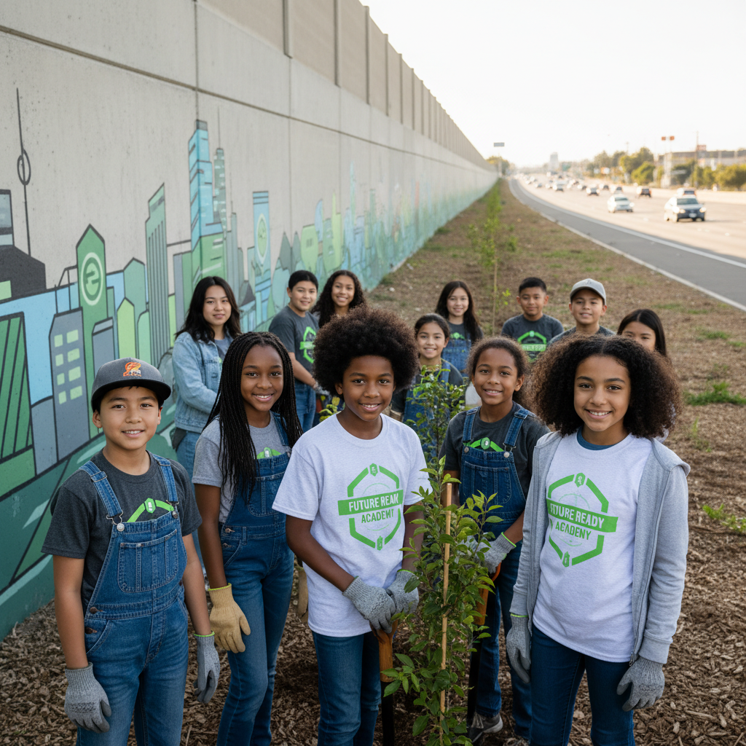
STEM Challenge: Design an Air Quality Solution
YOUR ENGINEERING MISSION
Propose a science-based solution to improve air quality near a freeway.
The Challenge:
A community near a freeway has high asthma rates. They can't move the freeway. Design a solution to help.
Think Like an Engineer:
* Can you reduce traffic pollution at the source?
* Can you block or filter pollution before it reaches homes?
* How will you measure if your solution works?
REAL CAREER CONNECTION: Environmental Health Scientists and Air Quality Monitors protect communities from pollution. They earn $60,000-$95,000/year. The skills you're using TODAY are the same ones they use on the job!
9/9

